Slide 1
PT Simulation
Md. Tareq Mahmood

Slide 2
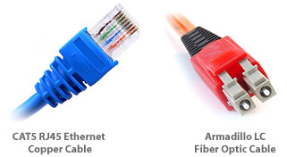
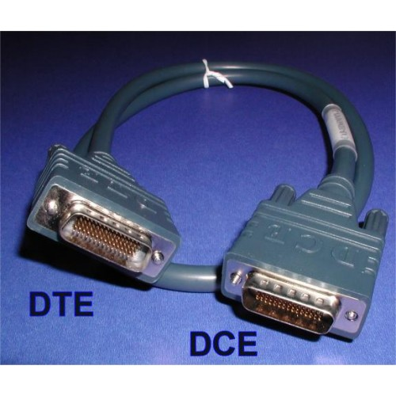
Copper vs. Fiber vs. Serial

Slide 3
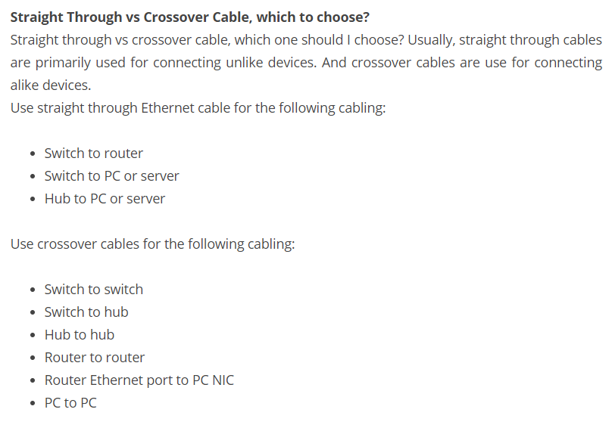
Copper Straight vs Crossover
http://www.cables-solutions.com/difference-between-straight-through-and-crossover-cable.html

Slide 4
Connection Steps
Place Devices
Connect Wires
Turn on ports of routers and switches
At this point all links should be up
If not, check port status

Slide 5
Network IP Assign
Set network address and subnet mask
Set router IP

Slide 6
End Device
Set IP
Set Default gateway ip

Slide 7
Troubleshoot
First ping fails.
Reason: https://www.pathsolutions.com/hubfs/PDF/PathSolutions-Why-Does-the-First-Ping-Usually-Fail.pdf
Try again.

Slide 8
Static Route
Define which neighbor to forward to
Takes
Network address
Mask
Next Hop

Slide 9
Default Route
A form of static route
Forward all packets to a specific node irrespective of destination ip address/network
Takes
Net address: 0.0.0.0
Mask: 0.0.0.0
Next Hop: <ip of default next node>

